Slide 1
Brief Hystory of EMC Europe
Jan Carlsson, Chair ISC EMC Europe

Slide 2
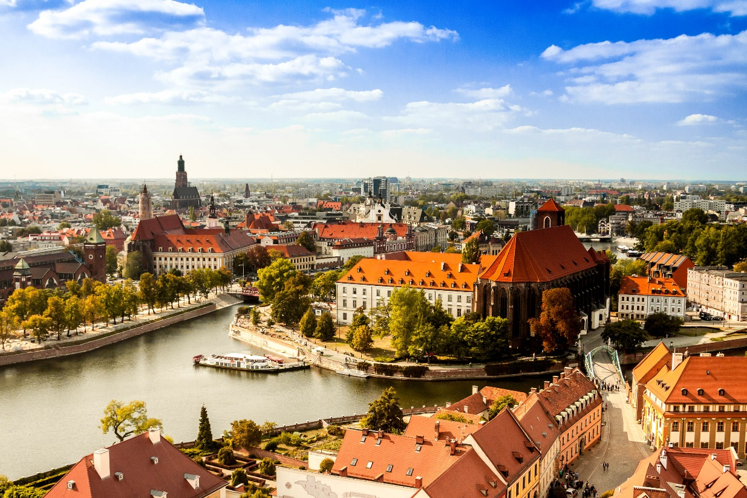
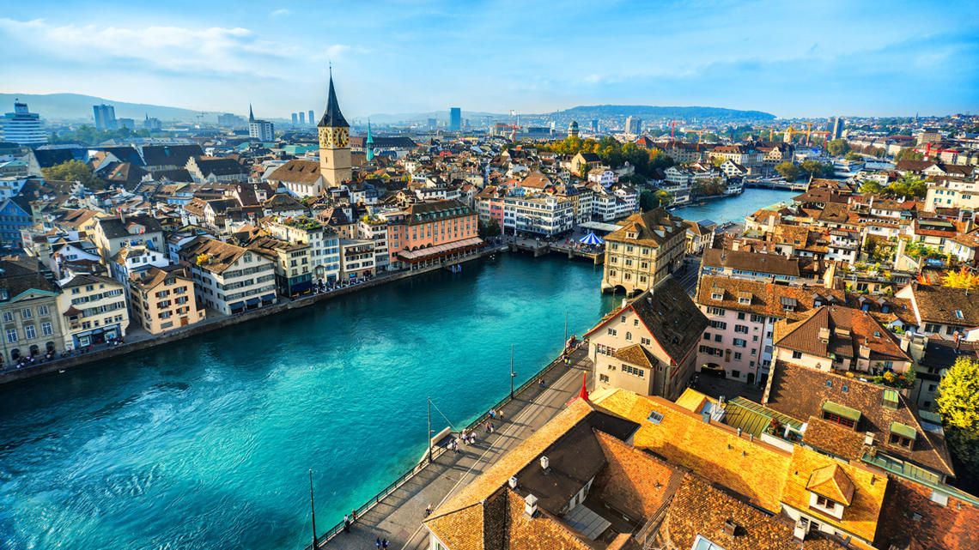
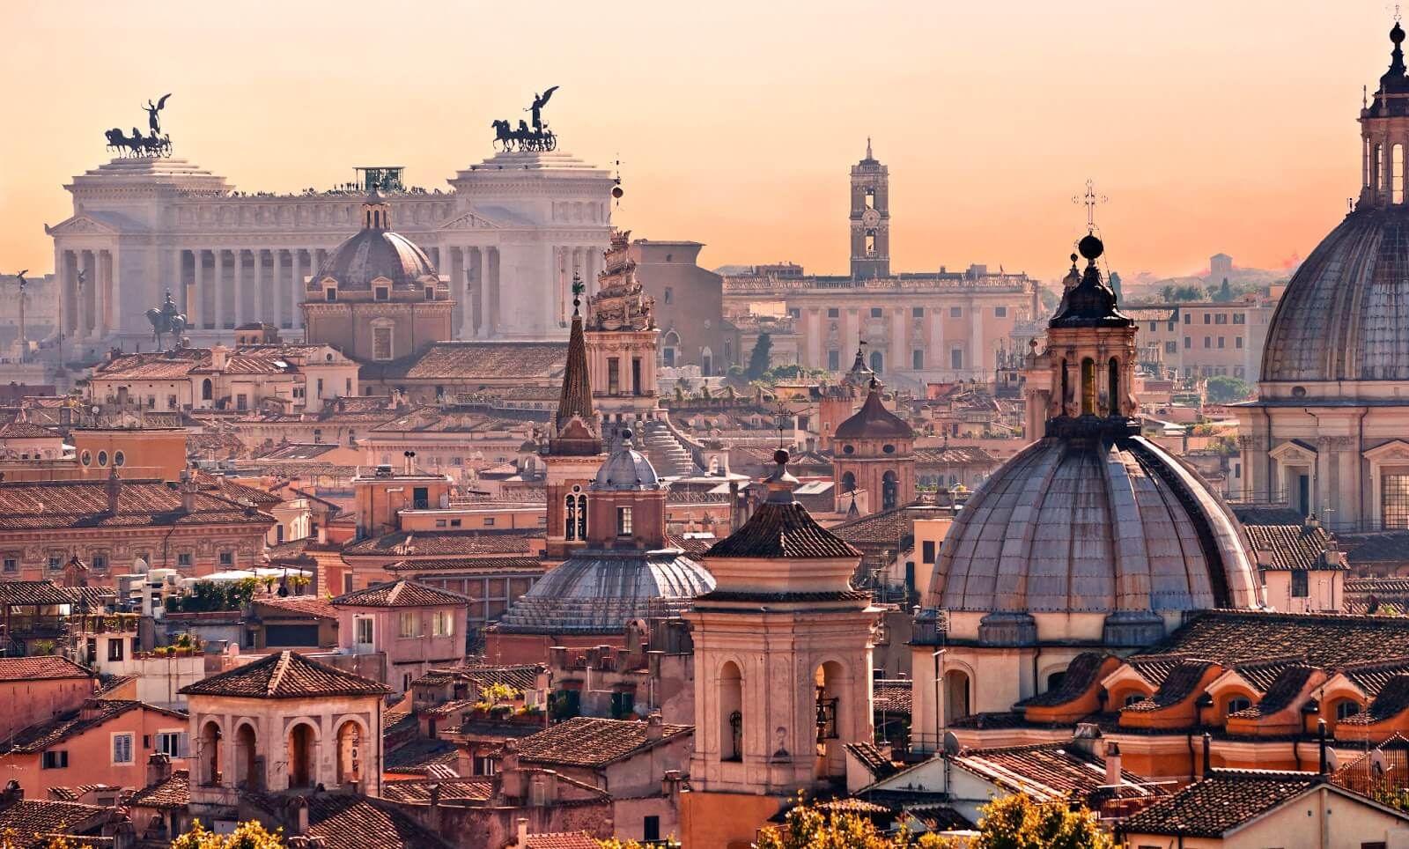
Europe has a long tradition of bi-annual conferences
Wroclaw
Wroclaw 1972 -
Zurich 1975 -
EMC Roma / EMC Europe 1994 -
Zurich
Roma

Slide 3
In 2010…
Wroclaw
Wroclaw 1972 -
Zurich 1975 -
EMC Roma / EMC Europe 1994 -
These conferences were merged into an annual conference under the name…
EMC Europe
Zurich
Roma

Slide 4
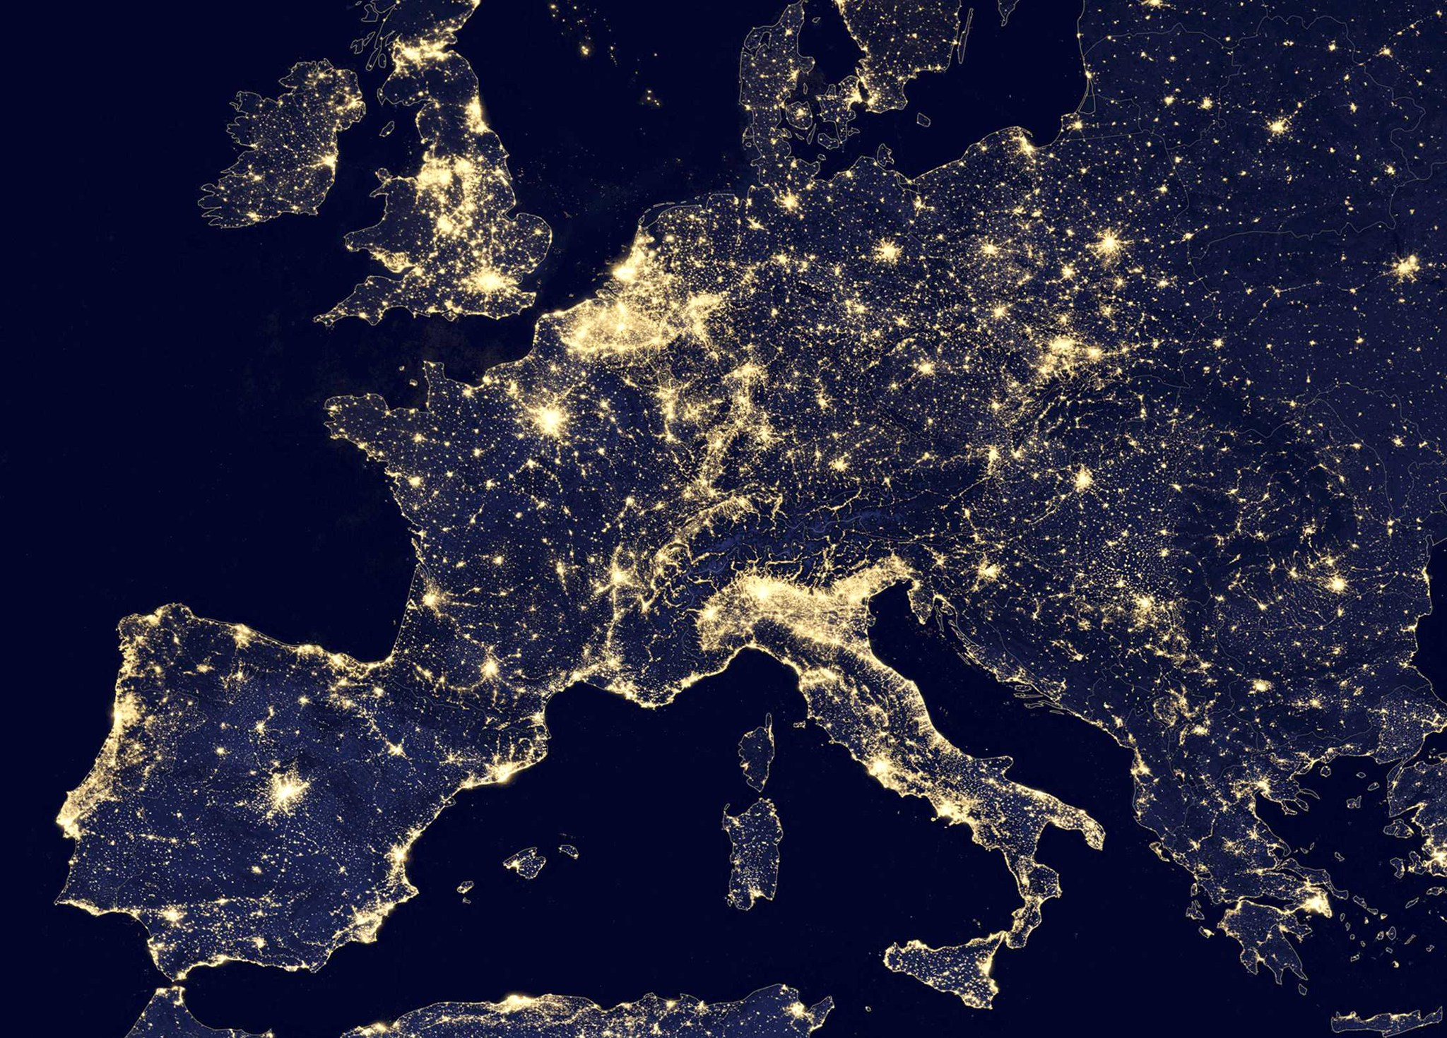
Glasgow
2021
Gothenburg
2014, 2022
York
2011
Amsterdam
2018
Brugge 2013
Wroclaw 2010, 2016
EMC Europe annual events
Dresden 2015
Angers 2017
Barcelona
2019
Roma 2012, 2020

Slide 5
Aim of EMC Europe
To organise international EMC conference with a high scientific level
To promote EMC research, innovation and international cooperation
This year:
249 submitted papers
Each reviewed by three reviewers
214 accepted papers, 86%
This year:
714 participants
80 registered students
Papers from 35 countries

Slide 6
Chairs of EMC Europe International Steering Committee
Marcello D’Amore, Italy, 1994-2006
Johan Catrysse, Belgium, 2006-2009
Jan Luiken ter Haseborg, Germany, 2009-2012
Mauro Feliziani, Italy, 2012-2015
Andy Marvin, UK, 2015-2018
Jan Carlsson, Sweden, 2018-

Slide 7
Many persons involved…
Local organising committee
Reviewers
Authors
Exhibitors
Sponsors
Delegates
…

